Slide 1
Text Mining, Information and Fact Extraction
Part 1: Introduction and Symbolic Techniques
Marie-Francine Moens
Department of Computer Science
Katholieke Universiteit Leuven, Belgium sien.moens@cs.kuleuven.be

Slide 2
Text

Slide 3
Text
Text = constellation of linguistic elements meant for human interpretation in a communicative act
Written (here focus) and spoken text

Slide 4
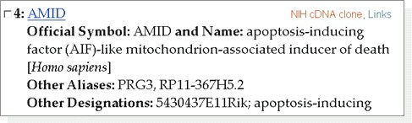
Sharapova beats Ivanovic to win Australian Open
A year after being on the wrong end of one of Russian didn't drop a set in seven matches at Melbourne Park, including wins the most-lopsided losses in a Grand Slam final, Sharapova wrapped up her third major title with a 7-5, 6-3 victory over fourth-seeded Ana Ivanovic on Saturday.The 20-year-old over three of the top four ranked players, erasing 12 months worth of painful memories in the wake of her 6-1, 6-2 loss to Serena Williams last year.After Ivanovic sprayed a forehand wide on match point, Sharapova dropped to her knees and appeared to be fighting back tears as she waved and blew kisses to the crowd.Then she dropped her racket in her chair before heading to shake hands and exchange high-fives with her father and supporters.
Great victory!
Tennis 2008
Date: Fri, 25 Jan 2008 11:21:15 +0100 (CET)
From: Maarten Logghe <maarten@yoru.be>
To: Sien Moens <sien.moens@cs.kuleuven.be>
Subject: Re: Op zoek naar een medewerker
Hoi Sien,
Ik vrees dat je nog wat verder zult moeten zoeken... ik kan het niet doen
en ik heb wat rondgevraagd bij vrienden en ex-collega's enzo maar helaas..
veel succes,
maarten
L’é tro bel cet voitur Voici tt ce ki me pasione ds ma petite vi!!!é tt mé pote é pl1 dotre truk!!!Avou de Dcouvrir

Slide 5
Mining

Slide 6
To mine
= to dig under to gain access
= to extract from a source
= ...
[Webster]

Slide 7
Information extraction

Slide 8
“Information extraction is the identification, and consequent or concurrent classification and structuring into semantic classes, of specific information found in unstructured data sources, such as natural language text, providing additional aids to access and interpret the unstructured data by information systems.”
[Moens 2006]

Slide 9
Fact extraction

Slide 10
= particular type of information extraction, focusing on factual information
fact = actual occurrence

Slide 11
Aim of the course
Text mining, information and fact extraction
To learn the latest techniques of fact extraction from text
To broaden the scope to more advanced information extraction and text mining
To illustrate with current applications
To integrate these techniques in retrieval models

Slide 12
Overview of the course
Part 1: Introduction and symbolic techniques
Part 2: Machine learning techniques
Part 3: Machine learning techniques (continued)
Part 4: Applications
Part 5: Integration in retrieval models

Slide 13
Overview of part 1
Examples from text, multimedia
Examples of typical information extraction tasks
The role of natural language processing
The role of machine learning
Evaluation
Going back in the history: the symbolic approaches and how to blend them in future approaches

Slide 14
Why do we need IE?
Huge amounts of unstructured data in a variety of media, languages and other formats
Need for the machine to help:
  Retrieval and searching
  Mining
  Summarizing and synthesis

Slide 15
How good is the machine already? Some examples

Slide 16
Named entity recognition
Boeing, Airbus vie for Qantus contract
December 4, 2005: 12:19 AM EST
SYDNEY (Reuters) - Qantas Airways Ltd., which will seek board approval this week to spend up to A$20 billion ($15 billion) on new planes, said on Sunday the contest between rival manufacturers was the closest it has seen.
Planemakers Boeing and Airbus are set to end a record year for new plane orders with a decision from Australia's Qantas, which has said it might need as many as 100 new planes.
Qantas chief executive Geoff Dixon said management had not decided on a final recommendation for Wednesday's board meeting, but fleet renewal was essential for the carrier, which also wants to expand its low-cost Jetstar airline internationally …

Slide 17
Noun phrase coreference resolution
Clinton was the third-youngest president, behind Theodore Roosevelt (the youngest president) and John F. Kennedy (the youngest to be elected president). He was the first baby boomer president. ...
The husband of Hillary Clinton ...

Slide 18
Relation recognition
Motorola, Inc. announced that the company and General Instrument Corporation completed their previously announced merger following GIC shareholder approval at a special meeting held Wednesday.

Slide 19
Event detection and linking
REDMOND, Wash., May 3, 2008 Microsoft Corp. (NASDAQ: MSFT) today announced that it has withdrawn its proposal to acquire Yahoo! Inc. (NASDAQ: YHOO).ﾒWe continue to believe that our proposed acquisition made sense for Microsoft, Yahoo! and the market as a whole. Our goal in pursuing a combination with Yahoo! was to provide greater choice and innovation in the marketplace and create real value for our respective stockholders and employees,ﾓ said Steve Ballmer, chief executive officer of Microsoft. ...
Breaking: Microsoft Withdraws Yahoo Bid; Walks Away From Deal (Updated)
Michael Arrington
Microsoft will announce shortly that they have withdrawn their offer to acquire Yahoo. Talks between the two companies and their advisors broke down earlier today, according to a source close to Microsoft, after a failure to come to agreement on price and other terms. ...
...
June 3: During a legal action against the Yahoo board for its alleged failure to act in shareholders' interest, documents reveal that Yahoo's management drew up plans to reject a Microsoft takeover three months before the $45bn offer was made. ...
REDMOND, Wash., May 3, 2008 ﾑ Microsoft Corp. (NASDAQ: MSFT) today announced that it has withdrawn its proposal to acquire Yahoo! Inc. (NASDAQ: YHOO).ﾒWe continue to believe that our proposed acquisition made sense for Microsoft, Yahoo! and the market as a whole. Our goal in pursuing a combination with Yahoo! was to provide greater choice and innovation in the marketplace and create real value for our respective stockholders and employees,ﾓ said Steve Ballmer, chief executive officer of Microsoft.ﾒDespite our best efforts, including raising our bid by roughly $5 billion, Yahoo! has not moved toward accepting our offer. After careful consideration, we believe the economics demanded by Yahoo! do not make sense for us, and it is in the best interests of Microsoft stockholders, employees and other stakeholders to withdraw our proposal,ﾓ said Ballmer.

Slide 20
Sharapova beats Ivanovic to win Australian Open
A year after being on the wrong end of one of Russian didn't drop a set in seven matches at Melbourne Park, including wins the most-lopsided losses in a Grand Slam final, Sharapova wrapped up her third major title with a 7-5, 6-3 victory over fourth-seeded Ana Ivanovic on Saturday.The 20-year-old over three of the top four ranked players, erasing 12 months worth of painful memories in the wake of her 6-1, 6-2 loss to Serena Williams last year.After Ivanovic sprayed a forehand wide on match point, Sharapova dropped to her knees and appeared to be fighting back tears as she waved and blew kisses to the crowd.Then she dropped her racket in her chair before heading to shake hands and exchange high-fives with her father and supporters.
Australian Open won by Maria Sharapova
Great victory!
Location: Melboune Park
Tennis 2008
Sports
Date: Fri, 25 Jan 2008 11:21:15 +0100 (CET)
From: Maarten Logghe <maarten@yoru.be>
To: Sien Moens <sien.moens@cs.kuleuven.be>
Subject: Re: Op zoek naar een medewerker
Hoi Sien,
Ik vrees dat je nog wat verder zult moeten zoeken... ik kan het niet doen
en ik heb wat rondgevraagd bij vrienden en ex-collega's enzo maar helaas..
veel succes,
maarten
Declining job offer
Non-spam
L’é tro bel cet voitur Voici tt ce ki me pasione ds ma petite vi!!!é tt mé pote é pl1 dotre truk!!!Avou de Dcouvrir
Positive sentiment

Slide 21
Information extraction: more examples
Extraction of details of an event:
  e.g., type of event, time, location, number of victims, symptoms of a disease, etc.
Extraction of information on Web page:
  e.g., e-mail, date of availability of a product, …
Extraction of opinions on certain topic
Extraction of scientific data from publications:
  e.g., localization of a gene, treatment of a disease, function of a gene,...
See PART 5
AND NOT ONLY TEXT !!!

Slide 22
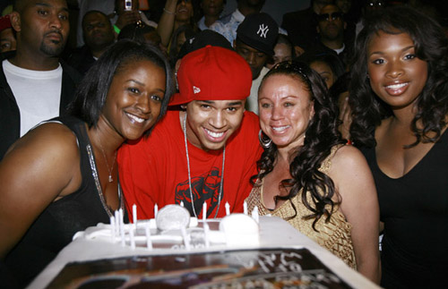
Birthday party
Happyness
Janet B.
Cake
Candles

Slide 23
Information extraction from text
Discipline in between NLP and IR in terms of difficulty and emphasis:
  NLP: theoretical basis: description of structural properties of language:
    syntactic, semantic and conceptual structure
    features, classification scheme
  IR: theoretical basis: mainly statistics and probability theory
Tested in ARPA’s Tipster Text Program and in the past Message Understanding Conferences (MUC), Automatic Content Extraction (ACE) and current Text Analysis Conference (TAC) (National Institute of Standards and Technology, NIST)

Slide 24
Role of natural language processing
Object of study = text written in natural language
Number of properties (features, attributes) that can be exploited
  Lexical features
  Morpho-syntactic features
  Semantic features
  Discourse features

Slide 25
Tokenization
Stemming
Removal of stopwords
heuristic: weight = 2

Slide 26
Lexical features
Tokenization = converting input stream of characters into a stream of words or tokens
  space-delimited languages (most European languages):
    word = string of characters separated by white space
  unsegmented languages (e.g., Chinese, Thai, Japanese):
    e.g., use of a word list (MRD = machine-readable dictionary)

Slide 27
Lexical features
Difficulties:
  1. use of special characters:
    e.g., period in abbreviation can be confused with words that end with a full stop at the end of sentence
    apostrophes
    hyphens
    => need for language specific rules
  2. normalization of numbers

Slide 28
Lexical features
Use of a finite state automaton or finite state machine:
  often integrates:
    transformations (e.g., case of letters, abbreviations and acronyms)
    removal of stopwords (caution!)

Slide 29
Morphological transformations
Lemmatization = finding the lemma or lexeme of an inflected word form (the lemma is the canonical dictionary entry form of the word)
Lookup of terms and their lemma in a machine-readable dictionary (MRD):
    correct (e.g., ponies -> pony)
    often large lists that need to be searched efficiently
    not always available or not all words covered

Slide 30
Morphological transformations
Stemming = reducing the morphological variants of the words to their stem or root
Affix removal algorithms:
  language dependent rules to remove suffixes and/or prefixes from terms leaving a stem
  possible language dependent transformation of the resulting stem
  examples:
    Lovins stemmer (1968)
    Porter algorithm (1980)

Slide 31
POS tagging and sentence parsing
Part-of-speech (POS) or syntactical word class:
  contributes to the meaning of the word in a phrase
  distinct component in syntactic structure
  content words: nouns, adjectives, verbs, adverbs
  function words: have functional properties in syntactic structure: act as determiners, quantifiers, prepositions and connectives (e.g., articles, pronouns, particles, …)

Slide 32
POS tagging and sentence parsing

Slide 33
POS tagging and sentence parsing
Parse features:
  Path: describes the path through the parse tree from the current word to the position of the predicate (verb), e.g., NNP↑NP↑PP↑NP↑S↓VP↓VBG:
    ↑= indicates going up one constituent
    ↓= indicates going down one constituent
  Split Path: the path feature causes an explosion of unique features: reduced by splitting the path in different parts and use every part as a distinct feature: e.g.: split of the above path in different features: NNP; ↑NP; ↑NP;↑PP; ↑S; ↓VP; ↓VBG

Slide 34
Other natural language features
Semantic features: e.g., from lexico-semantic resources, obtained in previous extraction tasks
Discourse features: e.g., discourse distance
And features typical for digital documents: e.g., HTML tags
These features describe the information unit to be classified and its context

Slide 35
The role of machine learning
Major advances in pattern classification today:
  Classification of objects (e.g., images, text, ...) into a number of categories:
    => recognition of content
  Many of the techniques involve machine learning and statistical classification

Slide 36
Supervised learning
Techniques of supervised learning:
  training set: example objects classified by an expert or teacher
  detection of general, but high-accuracy classification patterns (function or rules) in the training set based on object features and their values
  patterns are predictable to correctly classify new, previously unseen objects in a test set considering their features and feature values

Slide 38
Supervised learning
  Text classification can be seen as a:
    two-class learning problem:
      an object is classified as belonging or not belonging to a particular class
      convenient when the classes are not mutually exclusive
    single multi-class learning problem
  Result = often probability of belonging to a class, rather than simply a classification

Slide 39
Unsupervised learning
Techniques of unsupervised learning :
  natural groupings of similar objects are sought based object features and their values
  often use of simple hard and fuzzy clustering techniques

Slide 41
Weakly supervised learning
Techniques of weakly supervised learning
  supervised learning starting from a limited set of classified seed objects
  exploit knowledge from set of unlabeled examples
  often iterative learning until results on validation set cannot anymore be improved
  E.g., self-training, co-training

Slide 42
In this course
Information extraction originally developed for very limited domains, but interest in
  Portability of the techniques to other domains or to open domain
  Focus on supervised learning, because of high cost of hand-crafted patterns
Large interest in semi-supervised learning, because of high cost of labeling examples
  but, for natural language data difficult

Slide 43
Information extraction
Classification scheme = semantic labels and their relationships (external knowledge)
  Domain-independent: e.g., coreferent relations
  Domain-dependent: e.g., biomedical name classes
  Form:
    list
    hierarchy
    binary scheme
    ontology, labels can have relationships (e.g., hierarchically organized)

Slide 44
Evaluation: confusion matrix
Column: gives number of instances classified by system in the specific class
Row: gives number of instances classified by expert in the specific class
Easy to see if system confuses two classes
Built for binary and multi-class classification problems

Slide 45
Evaluation: confusion matrix
Confusion matrix of binary classification decisions (e.g., for intrinsic evaluation of e.g., text categorization, information extraction, classification in relevant - non-relevant documents):
System says yes System says no
Expert says yes tp fn
Expert says no fp tn
where
tp = true positives fn = false negatives
fp = false positives tn = true negatives

Slide 46
Evaluation: confusion matrix
    recall = tp / (tp + fn)
    precision = tp / (tp + fp)
    error rate = (fp + fn) / (tp + fp +fn + tn)
    accuracy = (tp + tn) / (tp + fp +fn + tn)

Slide 47
Evaluation: F-measure
F-measure: combines recall and precision
  where
  β = a factor that indicates the relative importance of recall and precision
  ideally close to 1
  when β = 1: also called harmonic mean= F₁

Slide 48
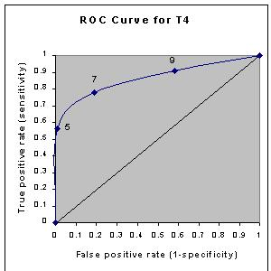
ROC curve
Receiver Operating Characteristic curve: area under curve should be maximized
1-specificity (= fp/(fp+tn))
sensitivity (= tp/(tp +fn))

Slide 49
The symbolic approaches

Slide 50
The symbolic approaches
Symbolic approaches rely on symbolic handcrafted knowledge
  drafted by a knowledge engineer, possibly helped by expert
  based on moderate-sized corpus that is manually inspected
Intuitive approach for extracting information from natural language texts

Slide 51
FMLN terrorists in retaliation for recent arrests attempted to kill 5 policemen with car bombs.
Task: to extract : the perpetrators (FMLN terrorists), the victims (5 policemen) and the weapons (car bombs).
The following extraction patterns would do the job:
    <perpetrator> attempted to kill
    <subj> verb infinitive
    attempted to kill <victim>
    verb infinitive <obj>
    to kill with <weapon>
    infinitive prep <np>

Slide 52
Early origin
° end 1960s and 1970s: Schank:
  defines all natural language words in terms of elementary primitives or predicates in an attempt of capturing the semantic content of a sentence
  conceptual dependency representation specifies semantic roles: the action of the sentence (e.g., as reflected by the verbs of the text) and the arguments (e.g., agent, object) and circumstances
  representations are ordered in a script, which outlines sequences of events or actions

Slide 53
  Sentence:
  Martin goes to Brussels.
  will be graphically represented in CD theory as follows:
  Brussels
  Martin ⇔ PTRANS Martin
    XX
  meaning that Martin performs the act of changing the location (PTRANS) of Martin from an unknown location (indicated by XX) to Brussels
  where O and D indicate an objective and a directive relationship respectively
O
D

Slide 54
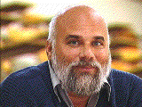
Script: human (X) taking the bus to go from LOC1 to LOC3
1. X PTRANS X from LOC1 to bus stop
2. bus driver PTRANS bus from LOC2 to bus stop
3. X PTRANS X from bus stop to bus
4. X ATRANS money from X to bus driver
5. bus driver ATRANS ticket to X
6.
7. bus driver PTRANS bus from bus stop to LOC3
8. X PTRANS X from bus to LOC3
(3), (7), (8): mandatory
[Schank 1975]
X gives money to the bus driver. ATRANS is used to express a transfer of an abstract relationship, in this case the possession of money.
Various subscripts handling actions possible during the ride.

Slide 55
Frame-based approaches
[Minsky 1975]: frame-based knowledge representations
  frames are often triggered by the occurrence of a certain word or phrase
  very partial analysis of the input text:
    algorithm tries to match natural language sentences with particular frames by simply filling out the slots in accordance with the constraints placed on them
    often top-down (expectation-driven): guided by the expected patterns to be found in the text
    robust: ignoring of irrelevant information
  template frames that outline the information can be used as output

Slide 56
Frame-based approaches
Implementation:
  Linguistic preprocessing of the text:
    POS tagging, parsing, named entity recognition, ...
  Mapping of the frames to the texts :
    feature slots: labels, fixed for a particular frame
    feature values: fill the slots with extracted information, certain constraints can be placed
  Frames can be connected in a semantic net
    advantages:
      default values, inherited values

Slide 57
Frame-based approaches
  Patterns to be identified can be encoded as regular expressions and recognized by finite state automaton
  Frames are often organized in a script:
    because of their strict organization, scripts have good predictive ability useful in information extraction

Slide 58
Frame-based approaches
Examples of some famous information extraction applications:
    FRUMP (DeJong, 1982): Yale University
    FASTUS (Hobbs et al., 1996): Stanford Research Institute

Slide 59
FASTUS
Finite state automaton implementation: set of cascaded, non-deterministic finite-state transducers
  application of symbolic rules in the form of hand-crafted regular expressions
  cascade: output of finite state transducer is input for next finite state transducer
[Hobbs et al. IJCAI 1993] [Hobbs JBioInformatics 2002]

Slide 60
Cascade of finite state transducers
1
Recognition of compound words and named entities
2. Partial parse: recognition of verb, noun, prepositional phrases, actives, passives, gerunds
2
3
3. Recognition of complex noun groups
4. Resolution to active form, recognition of information to be extracted
4
5. Structure merging
5

Slide 61
Example sentence:
  Bridgestone Sports Co. said Friday it has set up a joint venture in Taiwan with a local concern and a Japanese trading house to produce golf clubs to be shipped to Japan.

Slide 62
Step 2

Slide 63
Step 4
  Extraction rules:
  <Company/ies> {Set-up} {Joint-Venture} {with} <Company/ies>
{Produce} <Product>

Slide 64
Symbolic techniques: results
Successful systems, built and tested in many subject domains
e.g., MUC-7 (1998): subject domain of air plane crashes:
  performance of individual systems: largely similar
  certain information much easier to extract than others
Problem:
  infinite variety of subject domains: very difficult to exhaustively implement the symbolic knowledge
  very difficult to construct a script for every conceivable situation

Slide 65
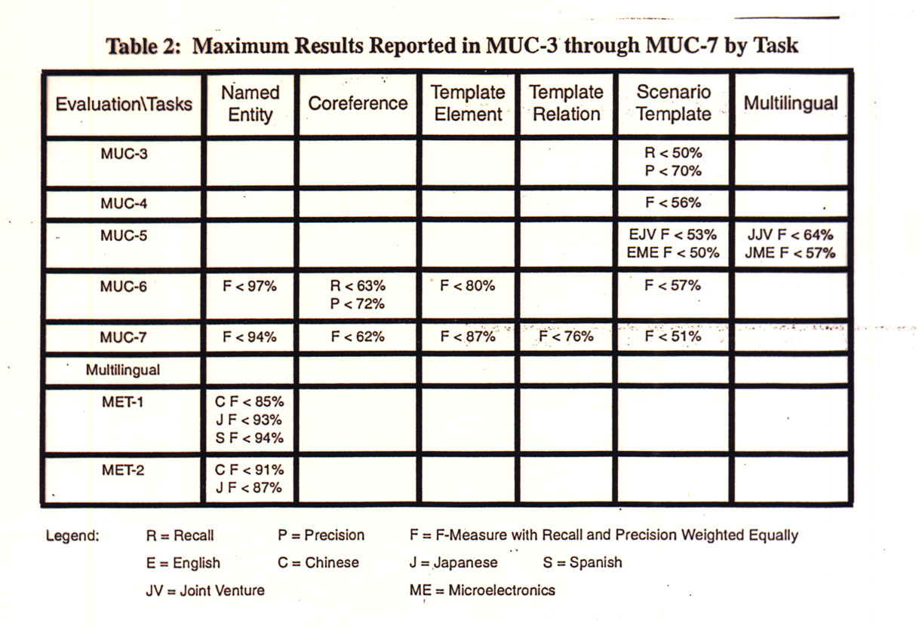

Slide 66
What to learn from the symbolic techniques?
They are very useful in case:
  the knowledge can be easily manually crafted
  the knowledge is stable and can be used in many applications
  the knowledge patterns are unambiguous
  Examples:
    syntactic reformulation rules
    rules for stemming

Slide 67
Today
Cf. example above: Similar pipelined structure, but (supervised) machine learning models:
  Named entity recognition (NER)
  Syntactic analysis of the sentence (e.g., part-of-speech tagging, sentence parsing)
  Recognition of relations between entities

Slide 68
References
DeJong, G. (1982). An overview of the FRUMP system. In W.G. Lehnert & M.H. Ringle (Eds.), Strategies for Natural Language Processing (pp. 149-176). Hillsdale: Lawrence Erlbaum.
Hobbs, J. H. et al. (1996). FASTUS: a cascaded finite-state transducer for
extracting information from natural-language text. In Finite State Devices
for Natural Language Processing. MIT Press, Cambridge MA.
Minsky, Marvin (1975). A framework for representing knowledge. In P.H. Winston (Ed.), The Psychology of Computer Vision (pp. 211-277). New York: McGraw-Hill.
Moens, M.-F. (2006). Information Extraction: Algorithms and Prospects in a Retrieval Context (The Information Retrieval Series 21). New York: Springer.
MUC-7 (1999). Message Understanding Conference Proceedings MUC-7.
Schank, R.C. (1975). Conceptual Information Processing. Amsterdam: North Holland.

